Slide 1
Language Basics

Slide 2
Java Basic Data Types
Primitive Data Types
Reference Data Types
Operators
Operator Precedence
Variable declaration
Variable Types
Block Structure
Control Flow Statements
Working with Arrays
Casting
Packages

Slide 3
Java Basic Data Types
Variables are nothing but reserved memory locations to store values. This means that when you create a variable you reserve some space in memory.
Based on the data type of a variable, the operating system allocates memory and decides what can be stored in the reserved memory. Therefore, by assigning different data types to variables, you can store integers, decimals, or characters in these variables.
There are two data types available in Java:
Primitive Data Types
Reference/Object Data Types

Slide 4
Primitive Data Types
Tip | Dimensiunea reprezentarii (numar de biti) | Valoarea minima a domeniului | Valoarea maxima a domeniului
boolean | 1 | false | true
byte | 8 | -2⁷ = -128 | 2⁷ -1= 127
short | 16 | -2¹⁵ = -32768 | 2¹⁵ -1= 32767
int | 32 | -2³¹ = -21474883648 | 2³¹ - 1= 21474883647
long | 64 | -2⁶³ = -9223372036854775808 | 2⁶³ -1= 9223372036854775807
char | 16 | \u0000 = 0 | \uffff = 65535
float | 32 | [-0x7f7fffff, -0x1] | [0x7f7fffff, 0x1]
double | 64 | [-0x7fefffffffffffff, -0x1] | [0x7fefffffffffffff, 0x1]

Slide 5
Reference Data Types
A reference type is a data type that’s based on a class. The class can be a class that’s provided as part of the Java API class, library or a class that’s written by ourselves.
When we create an object from a class, Java allocates the amount of memory the object requires to store the object. If we assign the object to a variable, the variable is actually assigned a reference to the object, not the object itself. This reference is the address of the memory location where the object is stored.
To declare a variable using a reference type, you simply list the class name as the data type. For example, the following statement defines a variable that can reference objects created from a class named Ball:
Ball b;
To create a new instance of an object from a class, you use the new keyword along with the class name:
Ball b = new Ball();
One of the key concepts in working with reference types is the fact that a variable of a particular type doesn’t actually contain an object of that type. Instead, it contains a reference to an object of the correct type. An important side effect is that two variables can refer to the same object.
Ball b1 = new Ball();
Ball b2 = b1;
Here, both b1 and b2 refer to the same instance of the Ball class.

Slide 6
Operators
Java provides a rich set of operators to manipulate variables. We can divide all Java operators into the following groups:
Arithmetic Operators
Relational Operators
Bitwise Operators
Logical Operators
Assignment Operators
Conditional Operator
Type comparison Operator

Slide 7
The Arithmetic Operators
Operator | Description
+ | Addition - Adds values on either side of the operator
- | Subtraction - Subtracts right hand operand from left hand operand
* | Multiplication - Multiplies values on either side of the operator
/ | Division - Divides left hand operand by right hand operand
% | Modulus - Divides left hand operand by right hand operand and returns remainder
++ | Increment - Increases the value of operand by 1
-- | Decrement - Decreases the value of operand by 1

Slide 8
The Relational Operators
Operator | Description
== | Checks if the values of two operands are equal or not, if yes then condition becomes true
!= | Checks if the values of two operands are equal or not, if values are not equal then condition becomes true
> | Checks if the value of left operand is greater than the value of right operand, if yes then condition becomes true
< | Checks if the value of left operand is less than the value of right operand, if yes then condition becomes true
>= | Checks if the value of left operand is greater than or equal to the value of right operand, if yes then condition becomes true
<= | Checks if the value of left operand is less than or equal to the value of right operand, if yes then condition becomes true

Slide 9
The Bitwise Operators
Operator | Description
& | Binary AND Operator copies a bit to the result if it exists in both operands
| | Binary OR Operator copies a bit if it exists in either operand
^ | Binary XOR Operator copies the bit if it is set in one operand but not both
~ | Binary Ones Complement Operator is unary and has the effect of 'flipping' bits
<< | Binary Left Shift Operator. The left operands value is moved left by the number of bits specified by the right operand
>> | Binary Right Shift Operator. The left operands value is moved right by the number of bits specified by the right operand
>>> | Shift right zero fill operator. The left operands value is moved right by the number of bits specified by the right operand and shifted values are filled up with zeros

Slide 10
The Logical Operators
Operator | Description
&& | Called Logical AND operator. If both the operands are non-zero, then the condition becomes true
|| | Called Logical OR Operator. If any of the two operands are non-zero, then the condition becomes true
! | Called Logical NOT Operator. Use to reverses the logical state of its operand. If a condition is true then Logical NOT operator will make false

Slide 11
The Assignment Operators
Operator | Description
= | Simple assignment operator, Assigns values from right side operands to left side operand
+= | Add AND assignment operator, It adds right operand to the left operand and assign the result to left operand
-= | Subtract AND assignment operator, It subtracts right operand from the left operand and assign the result to left operand
*= | Multiply AND assignment operator, It multiplies right operand with the left operand and assign the result to left operand
/= | Divide AND assignment operator, It divides left operand with the right operand and assign the result to left operand
%= | Modulus AND assignment operator, It takes modulus using two operands and assign the result to left operand

Slide 12
The Assignment Operators
Operator | Description
<<= | Left shift AND assignment operator
>>= | Right shift AND assignment operator
&= | Bitwise AND assignment operator
^= | bitwise exclusive OR and assignment operator
|= | bitwise inclusive OR and assignment operator

Slide 13
Conditional Operator
public class Test {
public static void main(String args[]){
int a , b;
a = 10;
b = (a == 1) ? 20: 30;
System.out.println( "Value of b is : " + b );
b = (a == 10) ? 20: 30;
System.out.println( "Value of b is : " + b );
}
}
Output:
Value of b is : 30
Value of b is : 20
Conditional operator is also known as the ternary operator. This operator consists of three operands and is used to evaluate Boolean expressions. The goal of the operator is to decide which value should be assigned to the variable

Slide 14
instanceof Operator
public class Test {
public static void main(String args[]){
String name = "James";
// following will return true since name is type of String
boolean result = name instanceof String;
System.out.println( result );
}
}
Output: true
class Vehicle { }
public class Car extends Vehicle {
public static void main(String args[]){
Vehicle a = new Car ();
boolean result = a instanceof Car;
System.out.println( result );
}
}
Output: true
instanceof operator is used only for object reference variables. The operator checks whether the object is of a particular type (class type or interface type).
If the object referred by the variable on the left side of the operator passes the IS-A check for the class/interface type on the right side, then the result will be true.

Slide 15
Operator Precedence
Priority | Operators | Operation | Associativity
1 | [ ] | array index | left to right
 | ( ) | method call
 | . | member access
2 | ++ | pre- or postfix increment | right to left
 | -- | pre- or postfix decrement
 | + - | unary plus, minus
 | ~ | bitwise NOT
 | ! | boolean (logical) NOT
 | (type) | type cast
 | new | object creation

Slide 16
Operator Precedence
Priority | Operators | Operation | Associativity
3 | * / % | multiplication, division, remainder | left to right
4 | + - | addition, substraction | left to right
 | + | string concatenation
5 | << | signed bit shift left | left to right
 | >> | signed bit shift right
 | >>> | unsigned bit shift right
6 | < <= | less than, less than or equal to | left to right
 | > >= | greater than, greater than or equal to
 | instanceof | reference test
7 | == | equal to | left to right
 | != | not equal to

Slide 17
Operator Precedence
Priority | Operators | Operation | Associativity
8 | & | bitwise AND | left to right
 | & | boolean (logical) AND
9 | ^ | bitwise XOR | left to right
 | ^ | boolean (logical) XOR
10 | | | bitwise OR | left to right
 | | | boolean (logical) OR
11 | && | boolean (logical) AND | left to right
12 | || | boolean (logical) OR | left to right
13 | ? : | conditional | right to left
14 | = | assignment | right to left
 | *= /= += -= %= <<= >>= >>>= &= ^= |= | combinated assignment (operation and assignment)

Slide 18
Operator Precedence
1. What is the result of the following code fragment ?
int x = 5;
int y = 10;
int z = ++x * y--;
result: 60
2. What does the following code fragment print ?
System.out.println( “1 + 2 = ” + 1 + 2 );
System.out.println( “1 + 2 = ” + ( 1 + 2 ));
Output1: 1 + 2 = 12
Output2: 1 + 2 = 3
3. Add parentheses to the following expression to make the order of evaluation more clear.
year % 4 == 0 && year % 100 != 0 || year % 400 == 0
(( year % 4 == 0 ) && ( year % 100 != 0 )) || ( year % 400 == 0 )

Slide 19
Variable declaration
Variable – a memory location that has an associated type. It contains a value that is compatible with variable’s type.
To declare a variable in Java, all that is needed is the data type followed by the variable name
int numberOfDays;
Before a variable can be used it must be given an initial value. This is called initializing the variable. If we try to use a variable without first giving it a value:
numberOfDays = numberOfDays + 10;
the compiler will throw an error: “variable numberOfDays might not have been initialized”
To initialize a variable we use an assignment statement. To give a variable a value, the left side is the name of the variable and the right side is the value:
numberOfDays = 7;
Remember:
Primitive variables keep their values in Stack Memory.
Reference variables keep the reference in Stack Memory, but object’s value in Heap Memory.
The scope of a variable is the part of the program in which that variable is valid.

Slide 20
Variable Types
Class variable – an attribute in a class declaration which uses the reserved word static or in an interface declaration (with or without static). It is created when the class is loaded.
Instance variable – an attribute in a class declaration without using the reserved word static.
Array’s components – created and initialized with default values every time a new array object is created.
Method’s parameter – argument’s value sent to a method
Constructor’s parameter – argument’s value sent to a constructor.
Exception handling parameter – created every time when an exception is catched.
Local variable – is declared within the body of a method.

Slide 21
Block Structure
int y = 1;
{
int x = 1;
x = x + y;
}
void testVariablesScope () {
System.out.println( “y = ” + y);
//compiler error – x cannot be resolved to a variable
System.out.println( “x = ” + x);
}
The block is the simplest type of structured statement. Its purpose is simply to group a sequence of statements into a single statement.
Inside a block can be declared variables. It is considered good style to declare a variable inside a block if that variable is used nowhere else but inside the block. A variable declared inside a block is completely inaccessible and invisible from outside that block. When the computer executes the variable declaration statement, it allocates memory to hold the value of the variable. When the block ends, that memory is discarded. The variable is said to be local to the block. In other words, the scope of a variable defined inside a block is limited to that block and more specifically to the part of the block that comes after the declaration of the variable.

Slide 22
Control Flow Statements
if
switch
while
do
for
break
continue
return
throw
synchronized
try
labels

Slide 23
Working with Arrays
Declaring an array
int [ ] intArray;
float [ ] floatArray;
char [ ] charArray;
Initializing an array
intArray = new int [10];
Using an array
int [ ] lotteryNumbers = new int [4];
lotteryNumbers [0] = 16;
lotteryNumbers [1] = 32;
lotteryNumbers [2] = 12;
lotteryNumbers [3] = 20;
int [ ] lotteryNumbers = {16 , 32 , 12 , 20};
String [ ] names = {“John” , “James” , “Julian” , “Jack”};
Multidimensional array
int [ ] [ ] lotteryNumbers = { {16 , 32 , 12 , 20} , {34 , 40 , 3 , 11} };

Slide 24
Casting
Casting represents different ways of, implicitly or explicitly, changing an entity of one data type into another. This is done to take advantage of certain features of type hierarchies or type representations. In object oriented programming, type conversion allows programs to treat objects of one type as one of their ancestor types to simplify interacting with them.
There are different types of casting:
Primitive Type Casting
Reference Type Casting

Slide 25
Primitive Type Casting
Primitive type casting allows converting primitive values from one type to another. Casts can be implicit or explicit. An implicit cast means you don’t have to write code for the cast; the conversion happens automatically. An implicit cast happens when we are doing a widening conversion. For example, putting a smaller thing (say, a byte) into a bigger container (like an int).
The large-value-into-small-container conversion is referred to as narrowing and requires an explicit cast, where you tell the compiler that you are aware of the danger and accept full responsibility.
int a = 100;
long b = a; // Implicit cast, an int value always fits in a long
double a = 100.001;
int b = (int) a; // Explicit cast, the float could lose info

Slide 26
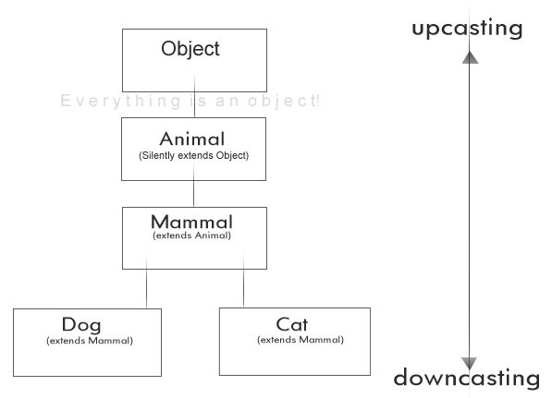
Reference Type Casting
There are two types of reference variable casting: downcasting and upcasting.
Downcasting: If we have a reference variable that refers to a subtype object, we can assign it to a reference variable of the subtype. We must make an explicit cast to do this and the result is that we can access the subtype’s members with this new reference variable.
Upcasting: We can assign a reference variable to a supertype reference variable explicitly or implicitly. This is an inherently safe operation because the assignment restricts the access capabilities of the new variable.

Slide 27
Reference Type Casting
class Animal {
int health = 100;
}
class Mammal extends Animal { }
class Cat extends Mammal { }
class Dog extends Mammal { }
public class Test {
public static void main(String[] args) {
Cat c = new Cat();
System.out.println(c);
Mammal m = c; // upcasting
System.out.println(m);
}
}
/* This printed: Cat@a90653 Cat@a90653 */
By casting we are not actually changing the object itself, we are just labelling it differently. If we create a Cat and upcast it to Animal, then the object doesn’t stop from being a Cat. It’s still a Cat, but it’s just treated as any other Animal and it’s Cat properties are hidden until it’s downcasted to a Cat again.

Slide 28
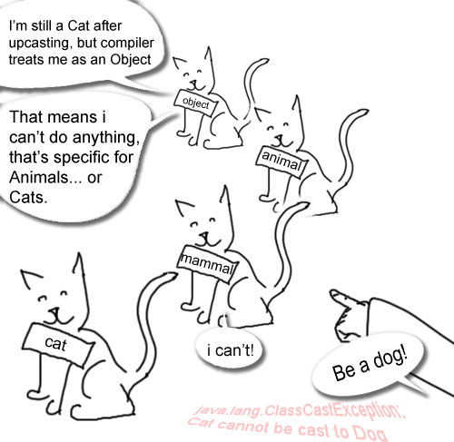
Reference Type Casting
Cat c1 = new Cat();
Animal a = c1; // automatic upcasting to Animal
if(a instanceof Cat){ // testing if the Animal is a Cat
System.out.println("It's a Cat! Now we can safely downcast it to a Cat, without a fear of failure.");
Cat c2 = (Cat)a; // manual downcasting back to a Cat
}

Slide 29
Packages
We use packages for the following reasons:
Grouping classes by a common role
Packages allow to avoid repeated code usage
Ensuring unique names for classes

Slide 30



Radu Baroncea
Developer
radu.baroncea@endava.com
069479862
radubaroncea

